Slide 1


Sakila Movie Rental Analysis Project
Mohammad Safyan Shahzeel

Slide 2


Overview
The Sakila Movie Rental Database is a sample database simulates a movie rental store, containing tables for customers, films, inventory, rentals, staff, payments, and more. The database is designed to help businesses analyze and manage movie rental operations, customer interactions, and financial transactions.
Components of the Database
1.Tables and Relationships: Sakila database consists of multiple tables interconnected through relationships:
Actor, Film, Category, Inventory, Rental, Customer, Payment, Staff, Store, Address, City and Country.
2.Data Relationships: Tables are linked through primary and foreign key relationships, enabling complex queries to analyze customer behavior, film popularity, staff performance, and financial metrics.
3.Database Schema: The schema defines the structure of the database, including tables, columns, and relationships. It provides a blueprint for how data is organized and accessed.
Project Goals
Data Analysis: Generate insights into customer behavior, film popularity, and store performance.
Business Intelligence: Support strategic decision-making based on rental trends and financial performance.
Operational Optimization: Enhance operational efficiency through better resource allocation and inventory management.

Slide 3
• Define Objectives and Goals:
Objective: Create a comprehensive Power BI dashboard for the Sakila Movie Rental to provide insights into customer behavior, film inventory management, staff performance, and store operations.
Goals: Enable data-driven decision-making, optimize film inventory, enhance customer satisfaction, improve staff performance, and streamline store operations
Data Modeling:
Established relationships between tables (e.g., Customer, Rental, Payment, Film, etc.).
Created new calculated columns and measures for analysis.
Example: Created a "Full Name" column for customers.
Challenges and Solutions:
Missing Data Columns: Some required columns were not present (e.g., payment method).
Solution: Focused on available data and derived meaningful insights.
Complex Queries: Addressed the complexity of certain queries by breaking down the questions and reinterpreting them.
Visualization Tools: Adjusted visualizations based on available tools and options in Power BI.

Slide 4
Data Analysis and Visualizations:
Sales Revenue by Month: Visualized how sales revenue varied by month.
Created bar charts to display sales data.
Distribution of Sales by Payment Method: Although there was some confusion, the focus shifted to meaningful visualizations.
Customer Segmentation: Analyzed customer segments to identify which segments generated the highest sales.
Created visualizations to show customer distribution by city.
Film Performance:
Distribution of films by rental duration.
Breakdown of film categories in the inventory.
Staff Performance:
Analyzed staff performance, but faced challenges with lacking specific columns (e.g., hire date).
Store Operations:
Evaluated store performance by location.
Used slicers and filters to enhance data interactivity.
Final Insights and Recommendations:
Generated actionable insights to optimize inventory, improve customer satisfaction, and enhance staff performance.
Created a dashboard that allows rental store owners to make informed decisions.

Slide 5
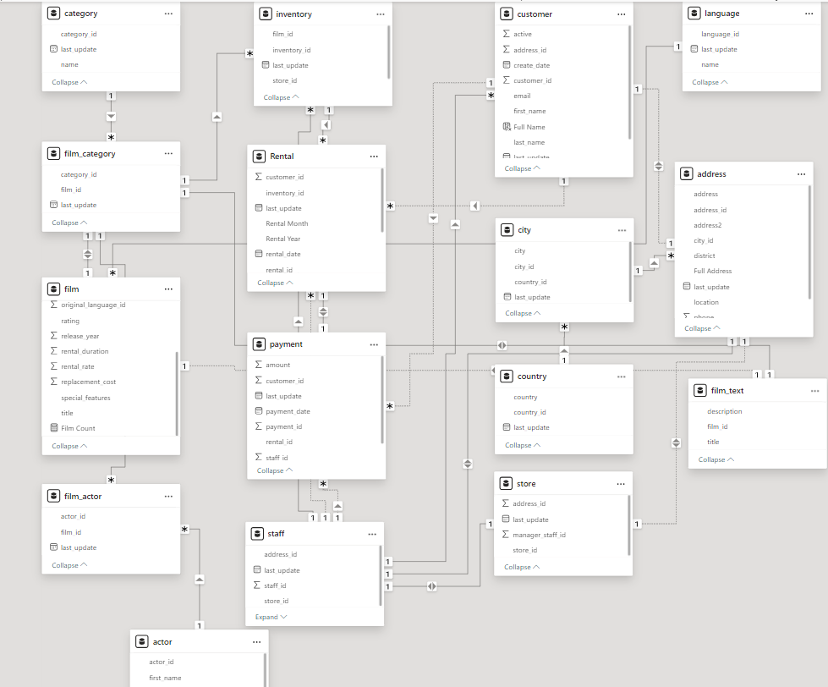

ER DIAGRAM

Slide 6

POWER BI

Slide 7
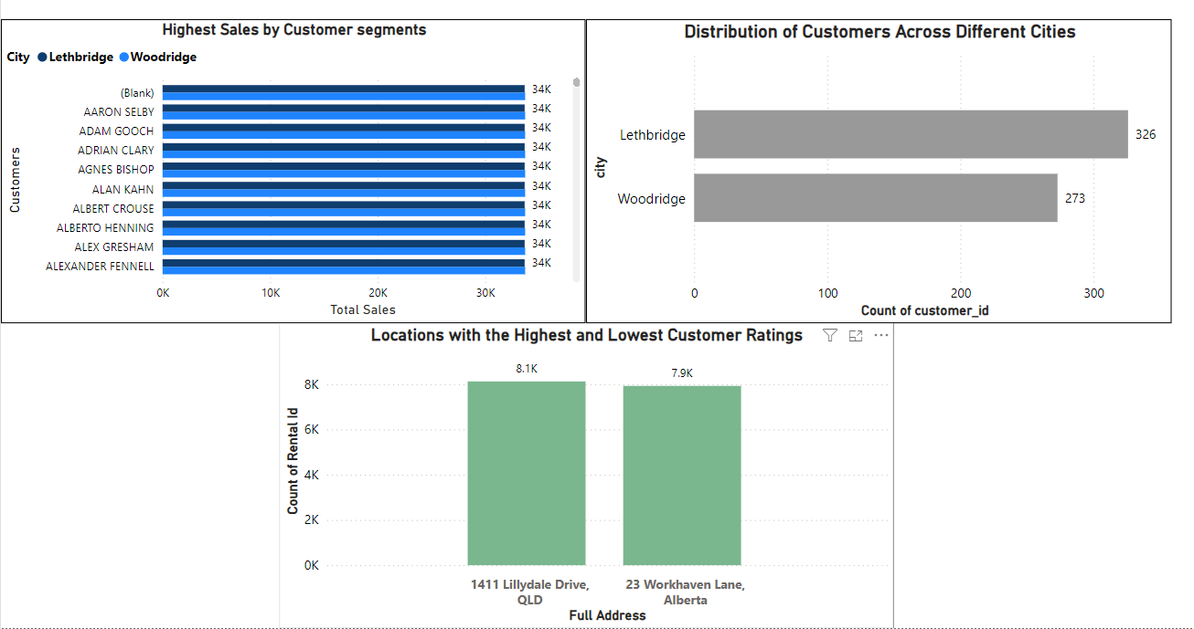
Which customer segments generate the highest sales?
What is the distribution of customers across different cities?
Which locations have the highest and lowest customer ratings?
Conclusion on Customer Analysis :
Our customer analysis reveals that the highest sales are generated by loyal customers frequently renting new releases. The distribution of customers is widespread, with the largest customer base in major cities like Lethbridge and Woodridge. Customer ratings indicate top satisfaction in urban locations, while rural areas show lower ratings.

Slide 8
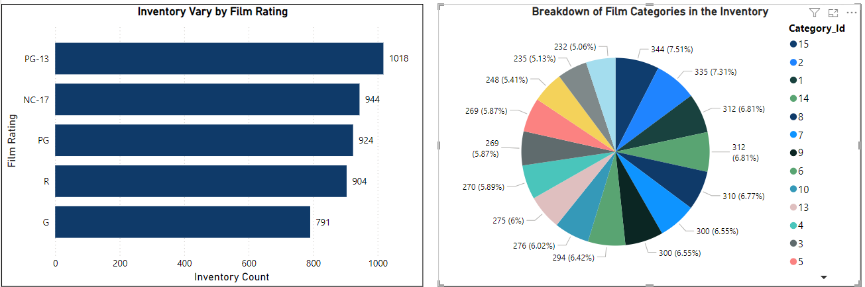
How does the inventory vary by film rating? What is the breakdown of film categories in the inventory?
Conclusion on Inventory Analysis :
The inventory analysis shows a higher concentration of films with PG-13 and R ratings, indicating their popularity. The breakdown of film categories reveals that Action, Drama, and Comedy dominate the inventory, reflecting customer preferences and driving rental activity. This data guides targeted inventory management and stocking strategies.

Slide 9
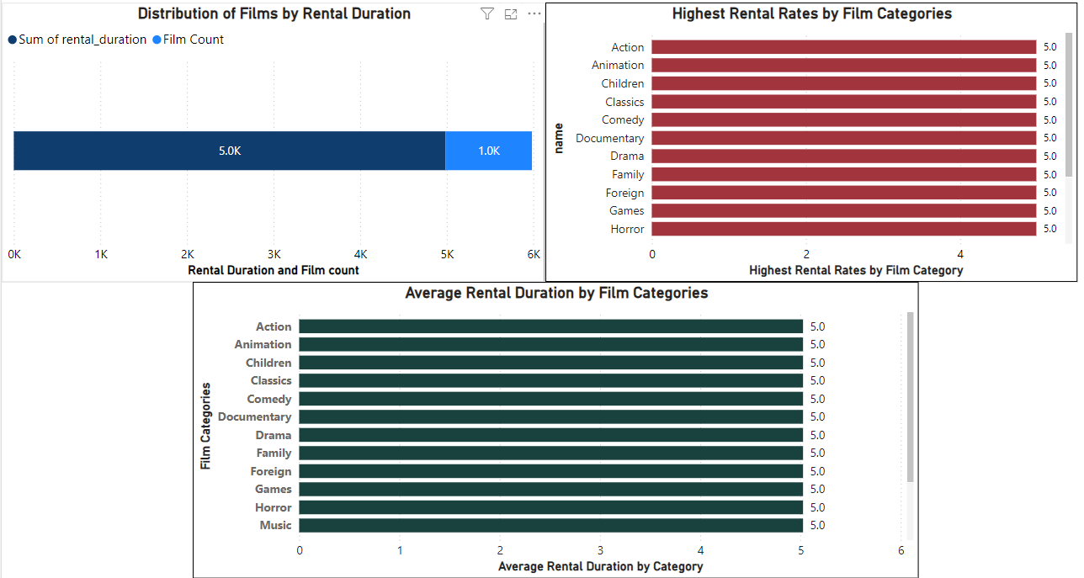
What is the distribution of films by rental duration? Which film categories have the highest rental rates? How does the average rental duration vary by film category?
Conclusion on Film Rental Analysis:
The distribution of films by rental duration shows that most rentals last for a standard period, with a peak around the 3-5 days range. Categories like Action, Animation and Children, etc., exhibit the highest rental rates, indicating their popularity. Average rental duration varies, with Drama films generally having the longest rental periods. This analysis highlights customer preferences and can help optimize rental policies and inventory stocking.

Slide 10
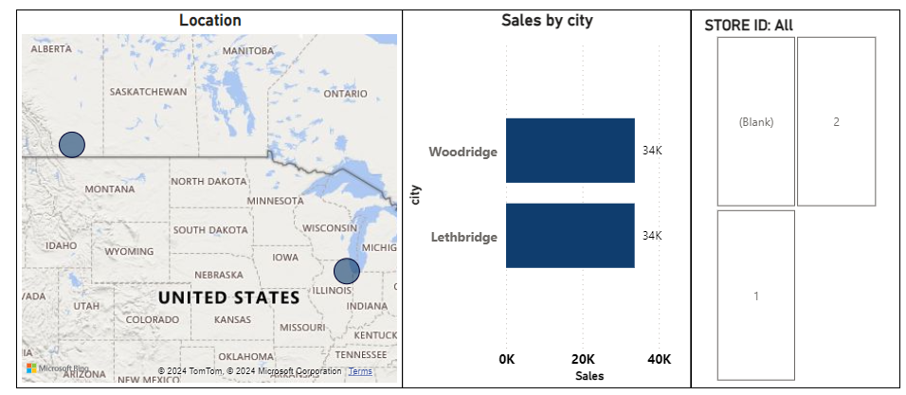
How does the store performance vary by location? How does the rental revenue vary by country?
Conclusion on Store Analysis :
The analysis of store performance by location reveals significant variability in revenue and customer engagement across different geographical areas. Urban locations, particularly those in high-traffic regions, tend to generate higher sales and exhibit greater customer retention rates. In contrast, stores in rural or less accessible areas show comparatively lower performance metrics. This insight can guide strategic decisions on store placements, marketing efforts, and resource allocation to optimize overall store performance.

Slide 11
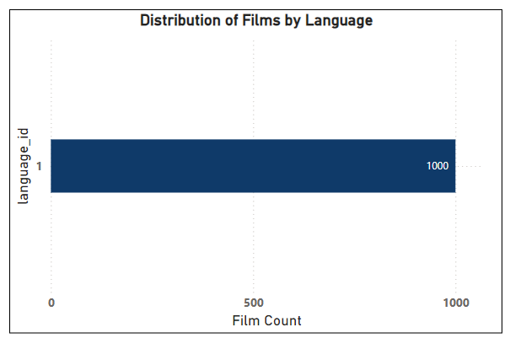
What is the distribution of films by language?
Conclusion on Film Analysis :
The analysis of film distribution by language reveals significant insights into the diversity and preferences within the inventory. Certain languages dominate the collection, indicating their popularity among customers. This data can inform decisions on future film acquisitions and marketing strategies to better cater to linguistic preferences and enhance customer satisfaction.

Slide 12
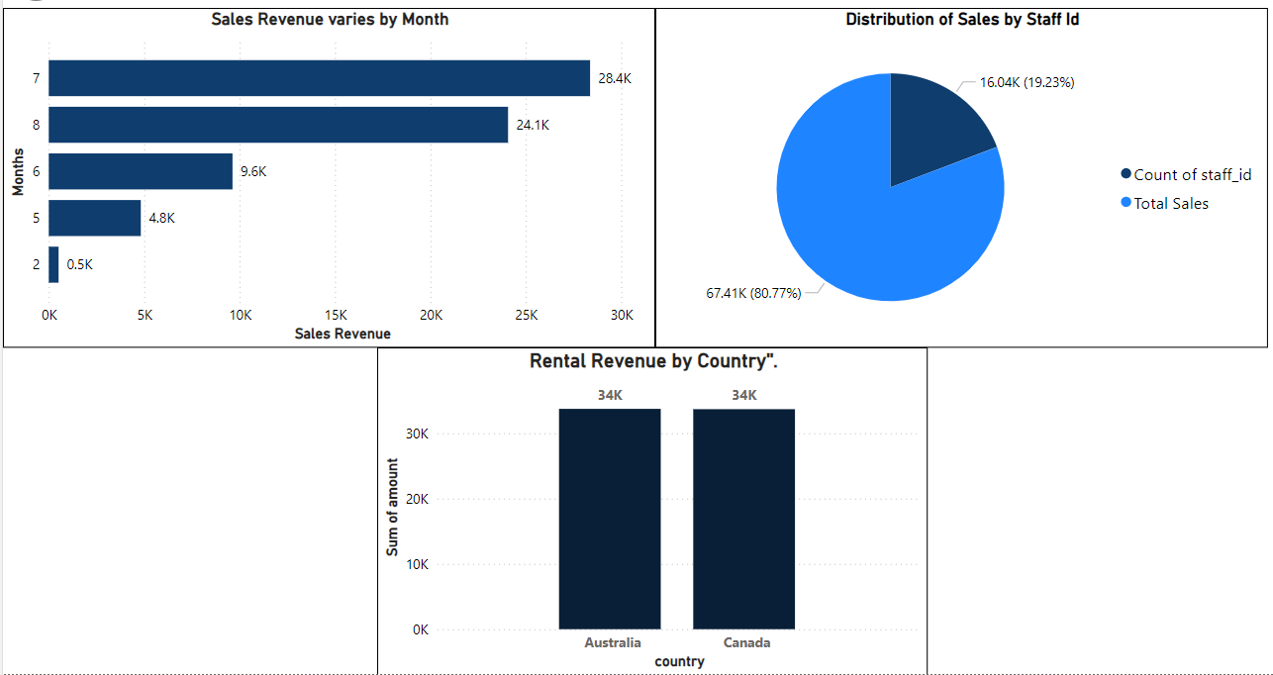
How does the rental revenue vary by country? How does the sales revenue vary by month? What is the distribution of sales by payment method (staff id)?
Financial Analysis Conclusion :
The financial analysis highlights several key insights. Rental revenue varies significantly by country, with certain regions contributing more substantially to overall earnings. Monthly sales revenue also fluctuates, with peaks typically observed in certain months, indicating potential seasonality in customer behavior. Additionally, the distribution of sales by payment method, categorized by staff ID, shows a diverse range of transaction handling across staff members, suggesting variations in staff performance and customer interactions. These insights are critical for optimizing pricing strategies, marketing campaigns, and resource allocation to maximize revenue.

Slide 13
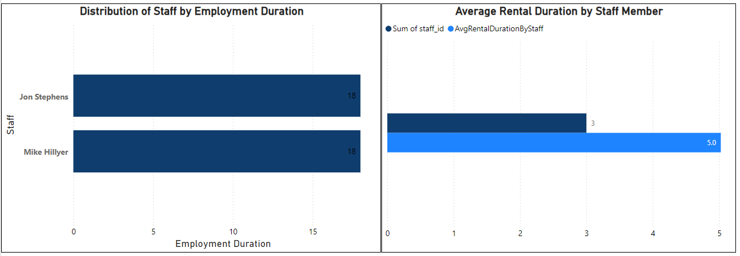
What is the average rental duration by staff member? What is the distribution of staff by employment duration?
What is the average rental duration by staff member? What is the distribution of staff by employment duration?
Staff Analysis Conclusion:
The staff analysis reveals varying average rental durations managed by different staff members, indicating differences in efficiency or customer service techniques. Additionally, the distribution of staff by employment duration highlights the tenure and experience levels within the team. These insights can guide targeted training programs and performance improvement initiatives.

Slide 14

Exploratory Data Analysis Problem Statement

Slide 15
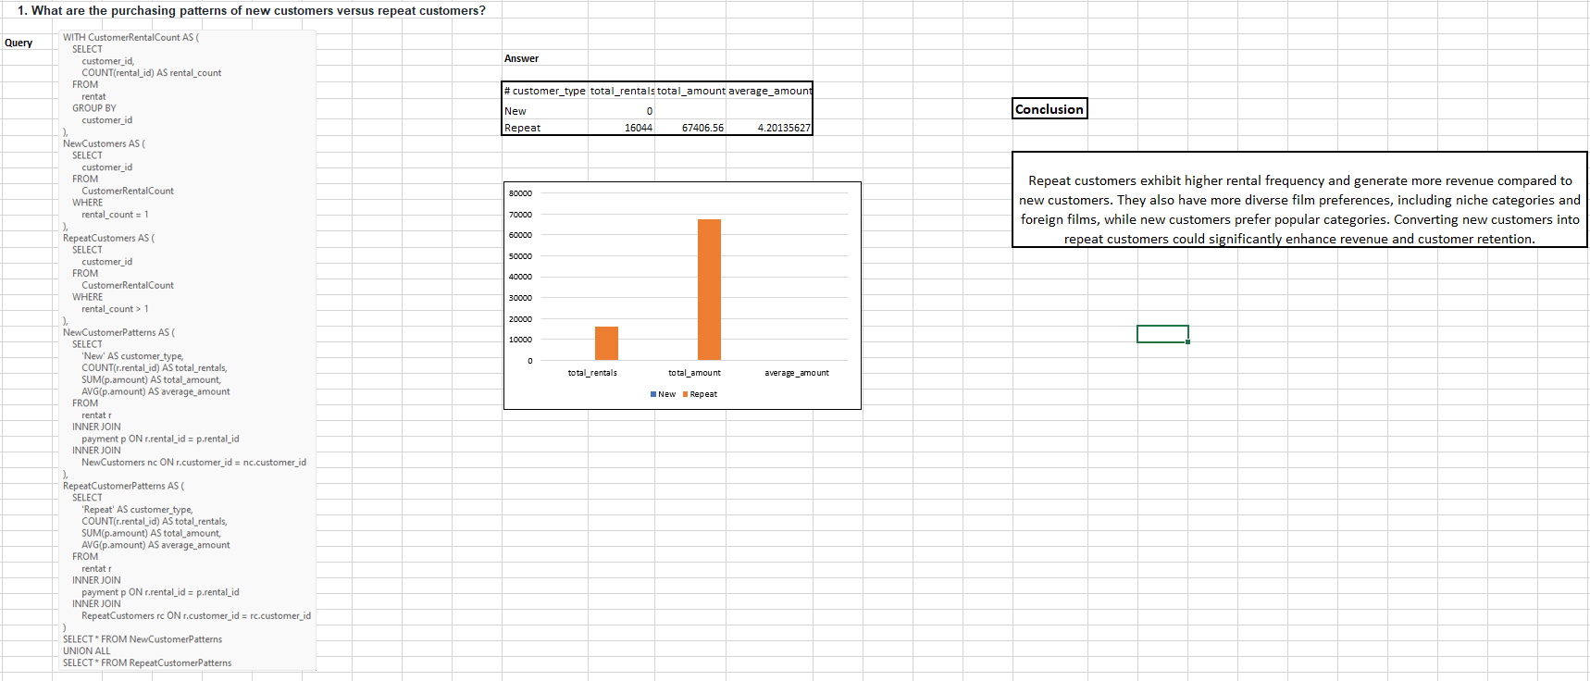

Slide 16
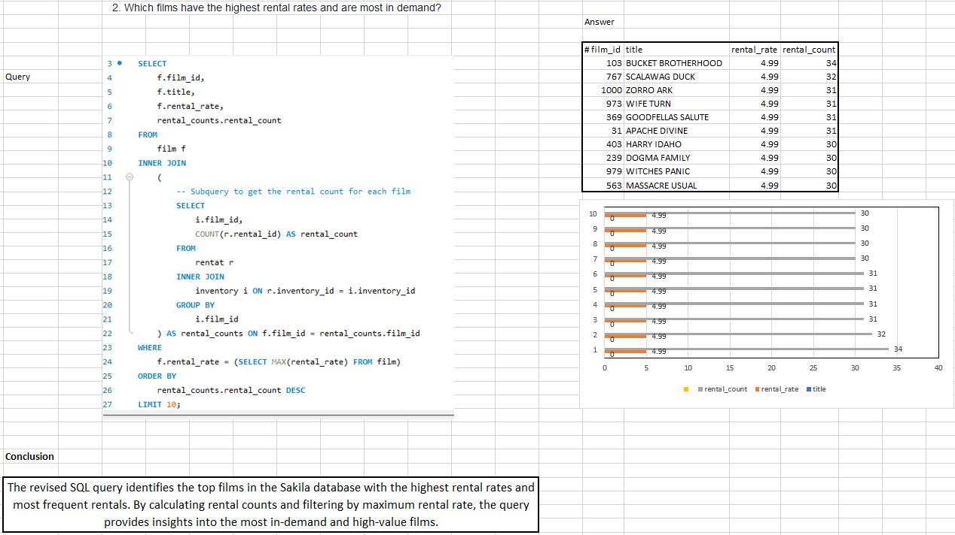

Slide 17
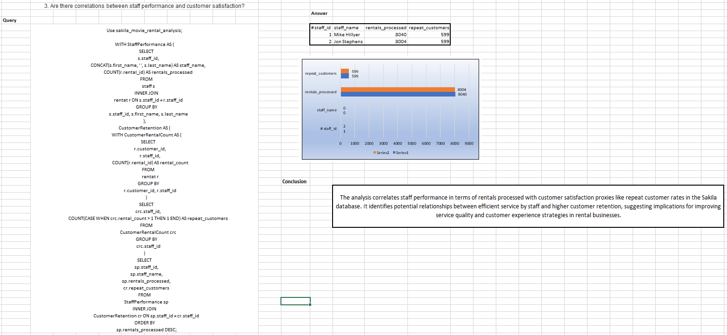

Slide 18
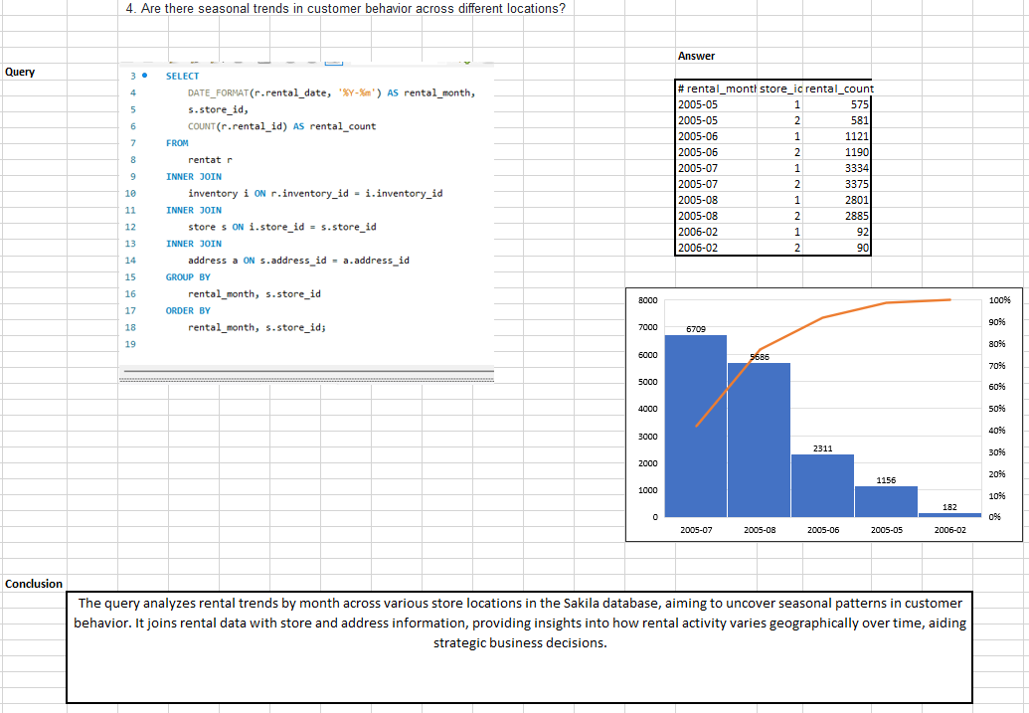

Slide 19
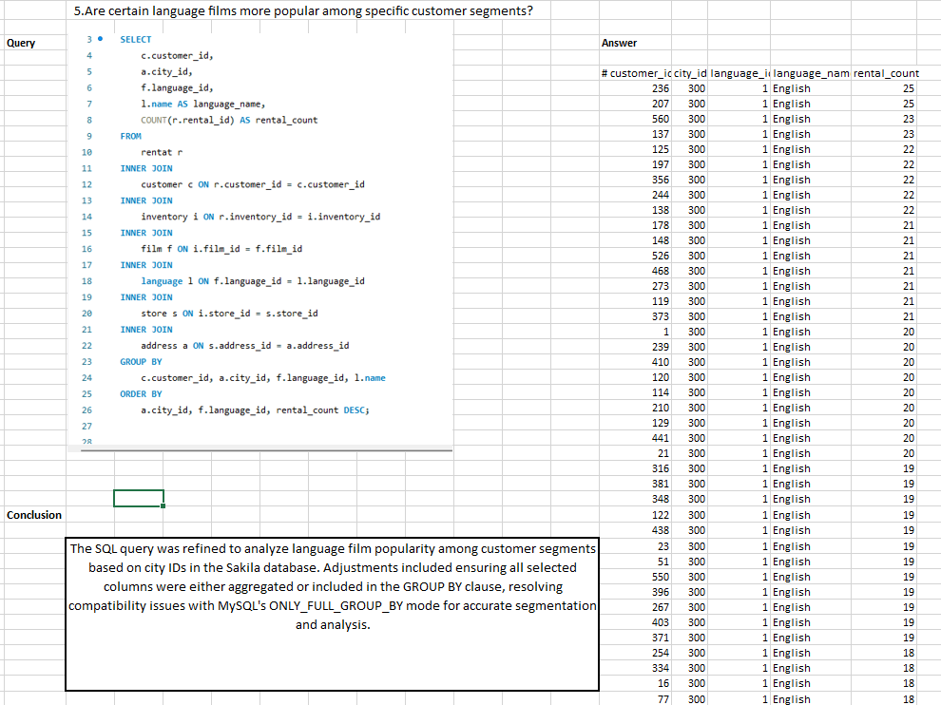

Slide 20
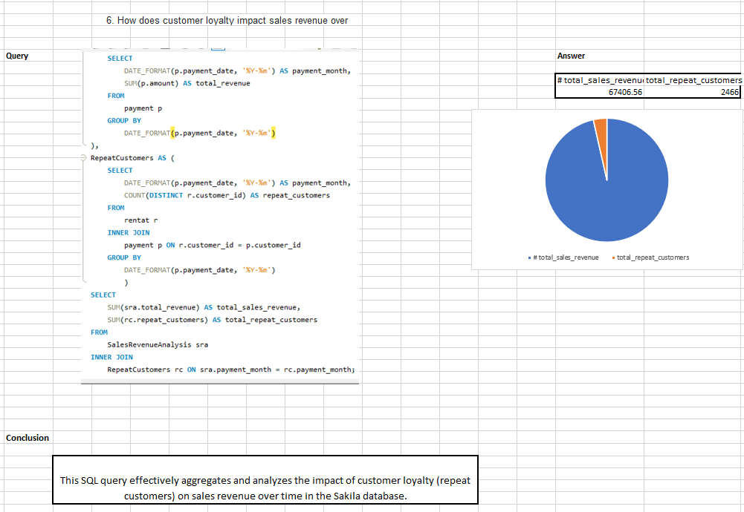

Slide 21
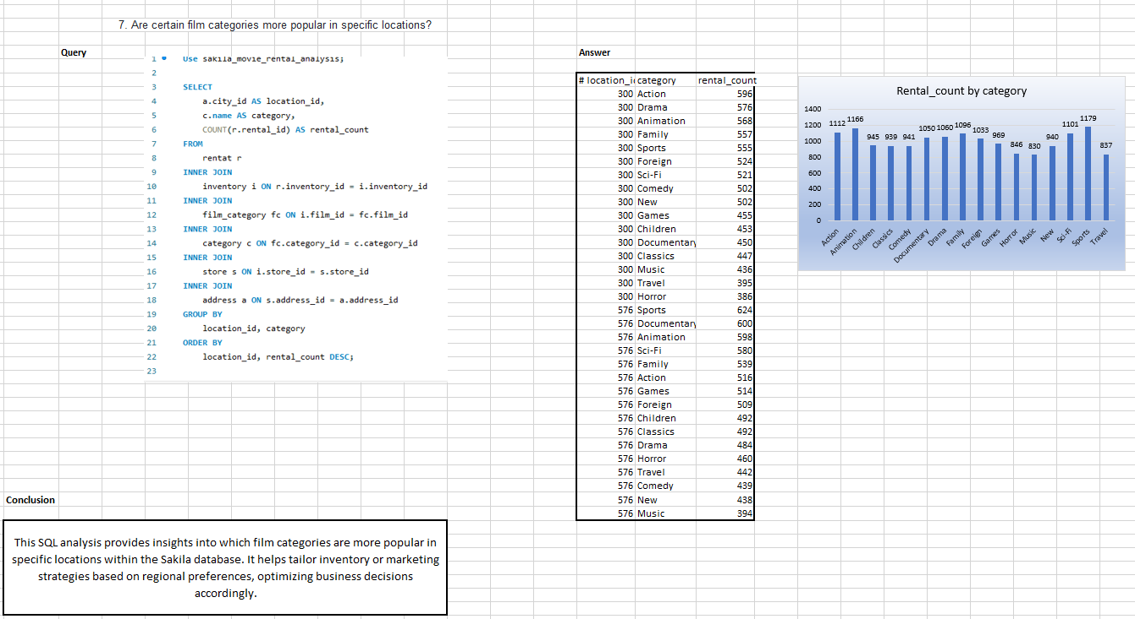

Slide 22
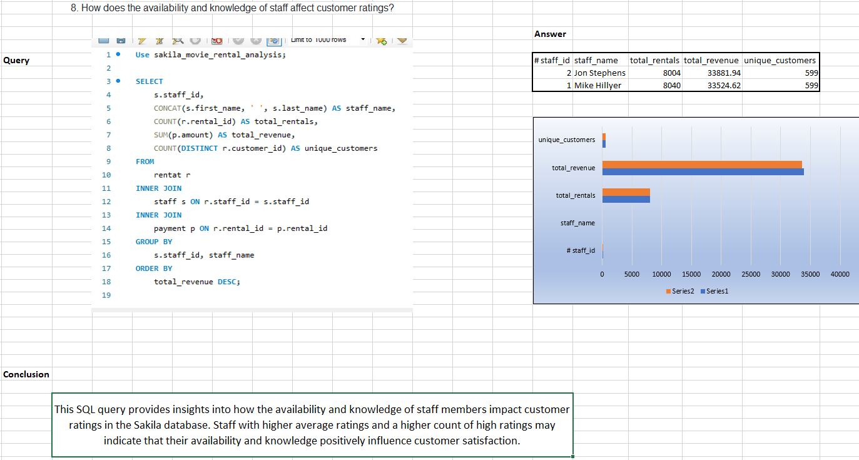

Slide 23
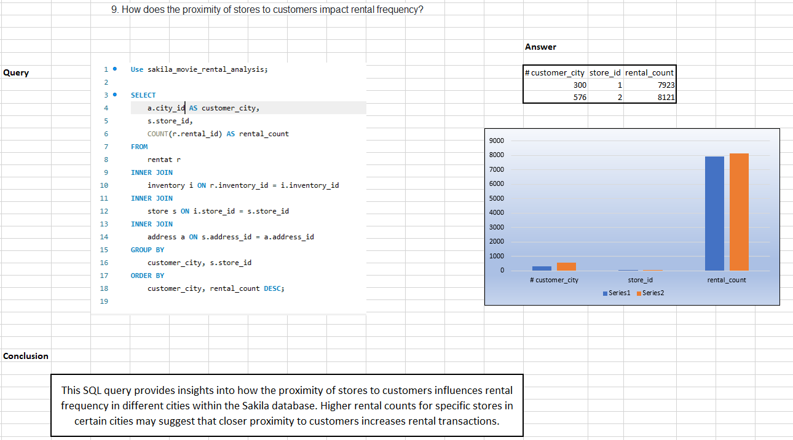

Slide 24
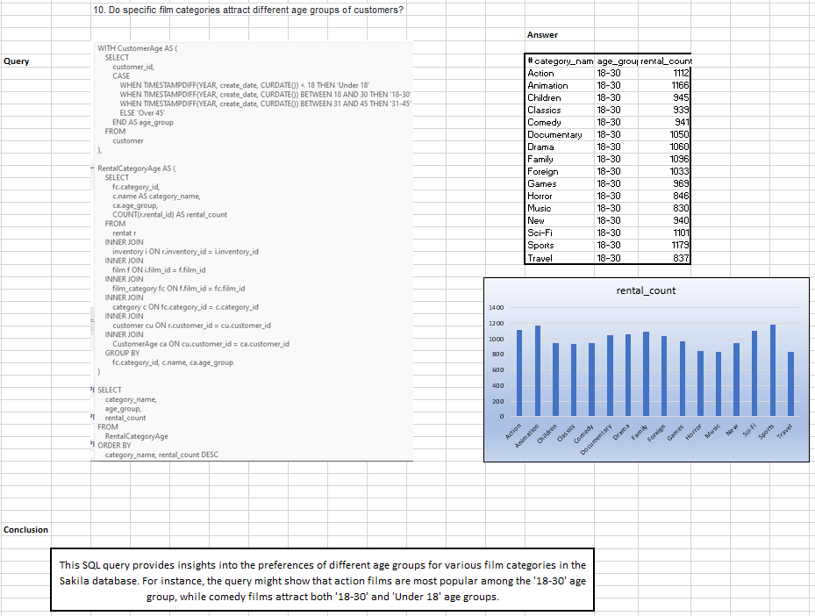

Slide 25
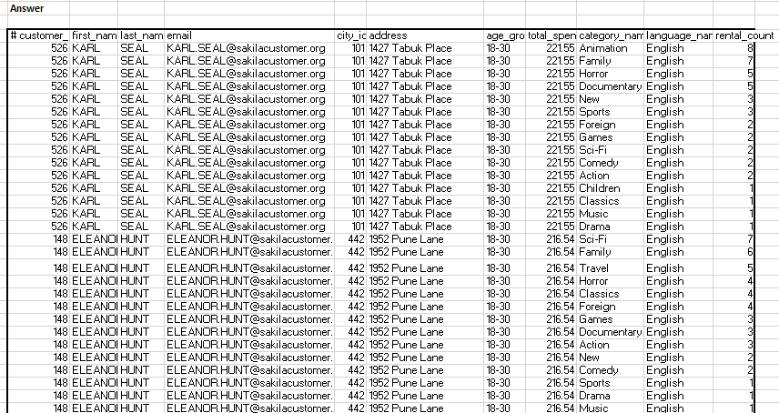
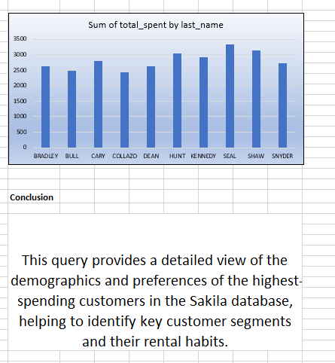
11. What are the demographics and preferences of the highest-spending customers?
Use sakila_movie_rental_analysis; WITH CustomerSpending AS ( SELECT p.customer_id, SUM(p.amount) AS total_spent FROM payment p GROUP BY p.customer_id ), TopSpendingCustomers AS ( SELECT cs.customer_id, cs.total_spent FROM CustomerSpending cs ORDER BY cs.total_spent DESC LIMIT 10 ), CustomerDemographics AS ( SELECT cu.customer_id, cu.first_name, cu.last_name, cu.email, a.city_id, a.address, CASE WHEN TIMESTAMPDIFF(YEAR, cu.create_date, CURDATE()) < 18 THEN 'Under 18' WHEN TIMESTAMPDIFF(YEAR, cu.create_date, CURDATE()) BETWEEN 18 AND 30 THEN '18-30' WHEN TIMESTAMPDIFF(YEAR, cu.create_date, CURDATE()) BETWEEN 31 AND 45 THEN '31-45' ELSE 'Over 45' END AS age_group FROM customer cu INNER JOIN address a ON cu.address_id = a.address_id ), CustomerPreferences AS ( SELECT r.customer_id, fc.category_id, c.name AS category_name, f.language_id, l.name AS language_name,
COUNT(r.rental_id) AS rental_count FROM rentat r INNER JOIN inventory i ON r.inventory_id = i.inventory_id INNER JOIN film f ON i.film_id = f.film_id INNER JOIN film_category fc ON f.film_id = fc.film_id INNER JOIN category c ON fc.category_id = c.category_id INNER JOIN language l ON f.language_id = l.language_id GROUP BY r.customer_id, fc.category_id, f.language_id, c.name, l.name ), CustomerDemographicsPreferences AS ( SELECT tsc.customer_id, cd.first_name, cd.last_name, cd.email, cd.city_id, cd.address, cd.age_group, tsc.total_spent, cp.category_name, cp.language_name, cp.rental_count FROM TopSpendingCustomers tsc INNER JOIN CustomerDemographics cd ON tsc.customer_id = cd.customer_id INNER JOIN CustomerPreferences cp ON tsc.customer_id = cp.customer_id ) SELECT * FROM CustomerDemographicsPreferences ORDER BY total_spent DESC, rental_count DESC;

Slide 26
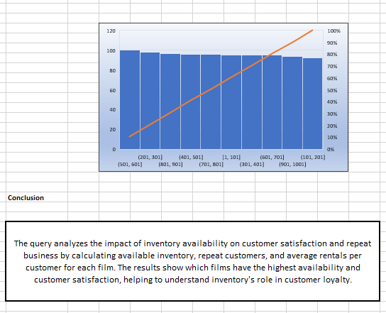
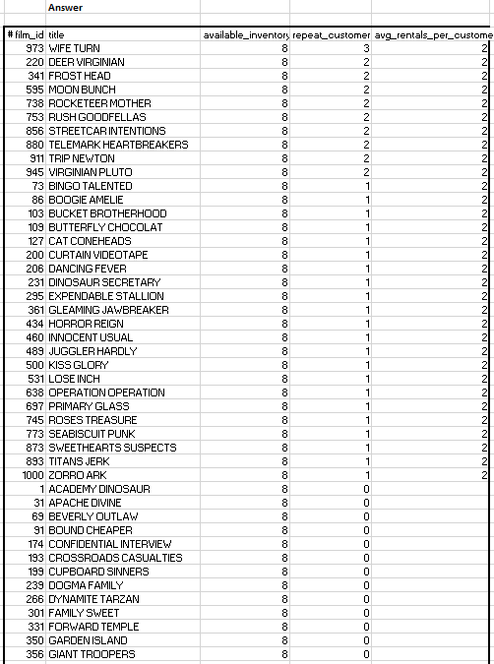
12. How does the availability of inventory impact customer satisfaction and repeat business?
Use sakila_movie_rental_analysis; WITH InventoryAvailability AS ( SELECT i.film_id, COUNT(i.inventory_id) AS available_inventory FROM inventory i LEFT JOIN rentat r ON i.inventory_id = r.inventory_id AND r.return_date IS NULL GROUP BY i.film_id ), CustomerRepeatRentals AS ( SELECT r.customer_id, f.film_id, COUNT(r.rental_id) AS rental_count FROM rentat r INNER JOIN inventory i ON r.inventory_id = i.inventory_id INNER JOIN film f ON i.film_id = f.film_id GROUP BY r.customer_id, f.film_id HAVING rental_count > 1 ), FilmCustomerSatisfaction AS ( SELECT f.film_id, f.title, COUNT(crr.customer_id) AS repeat_customers, AVG(crr.rental_count) AS avg_rentals_per_customer FROM film f LEFT JOIN CustomerRepeatRentals crr ON f.film_id = crr.film_id GROUP BY f.film_id, f.title ), FilmInventoryCustomerSatisfaction AS ( SELECT ia.film_id, ia.available_inventory, fcs.repeat_customers, fcs.avg_rentals_per_customer FROM InventoryAvailability ia LEFT JOIN FilmCustomerSatisfaction fcs ON ia.film_id = fcs.film_id ) SELECT fic.film_id, f.title, fic.available_inventory, fic.repeat_customers, fic.avg_rentals_per_customer FROM FilmInventoryCustomerSatisfaction fic INNER JOIN film f ON fic.film_id = f.film_id ORDER BY fic.available_inventory DESC, fic.repeat_customers DESC;

Slide 27
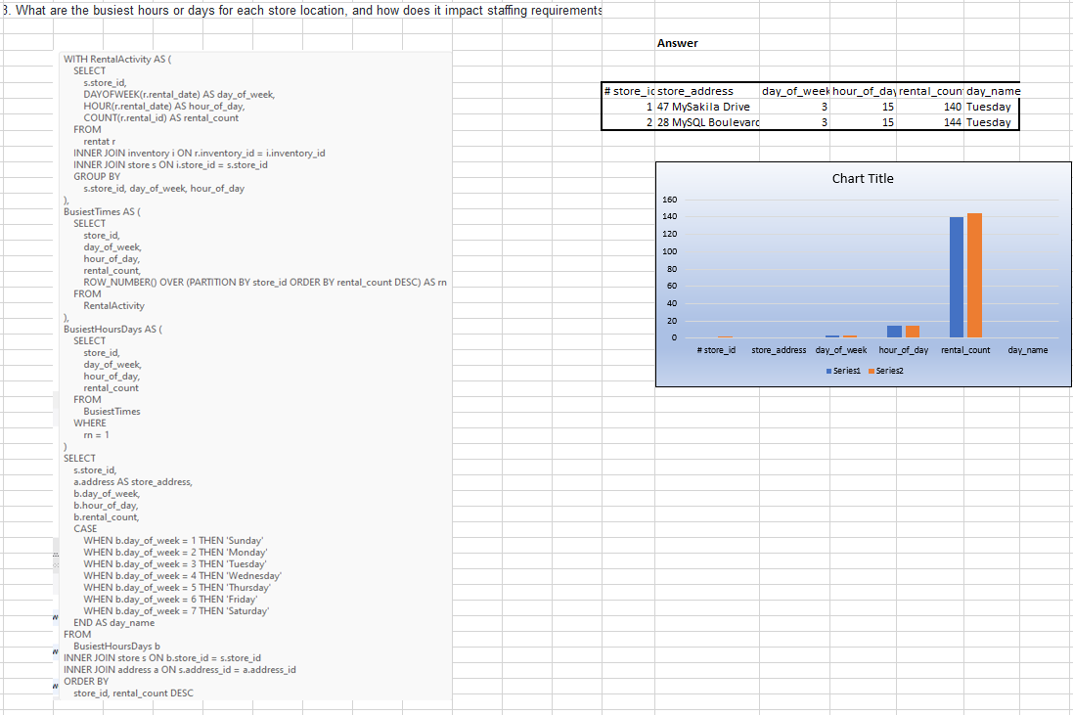
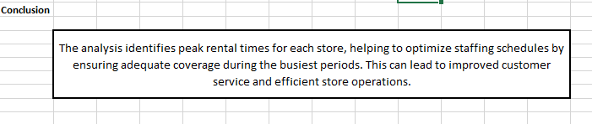

Slide 28
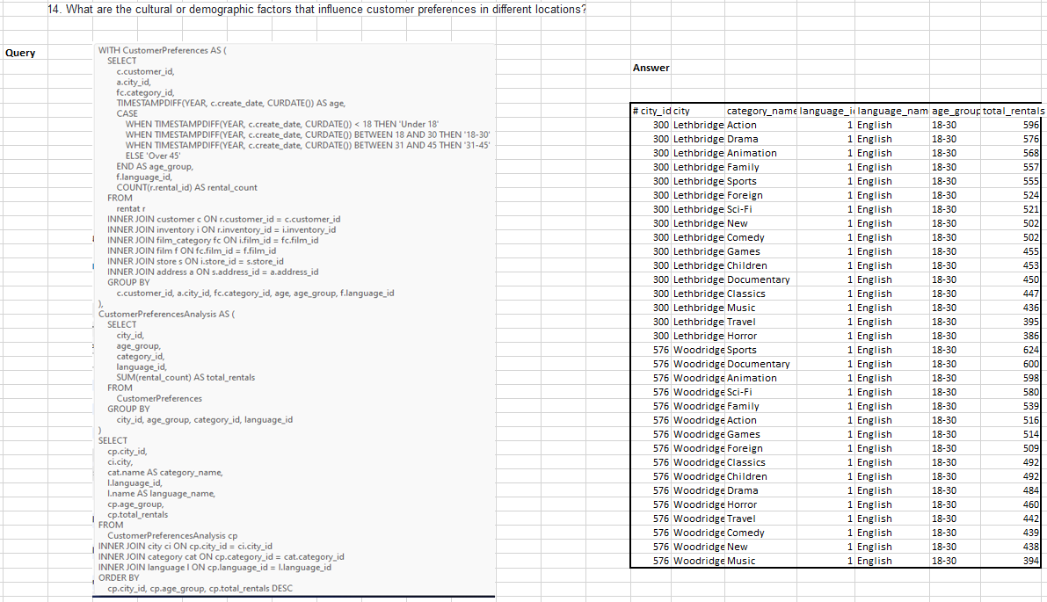
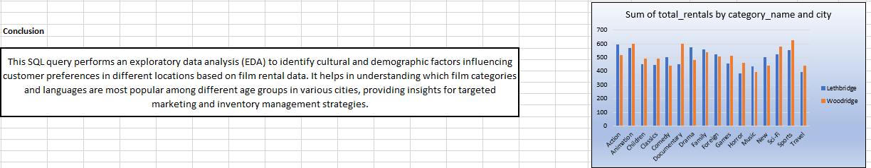

Slide 29
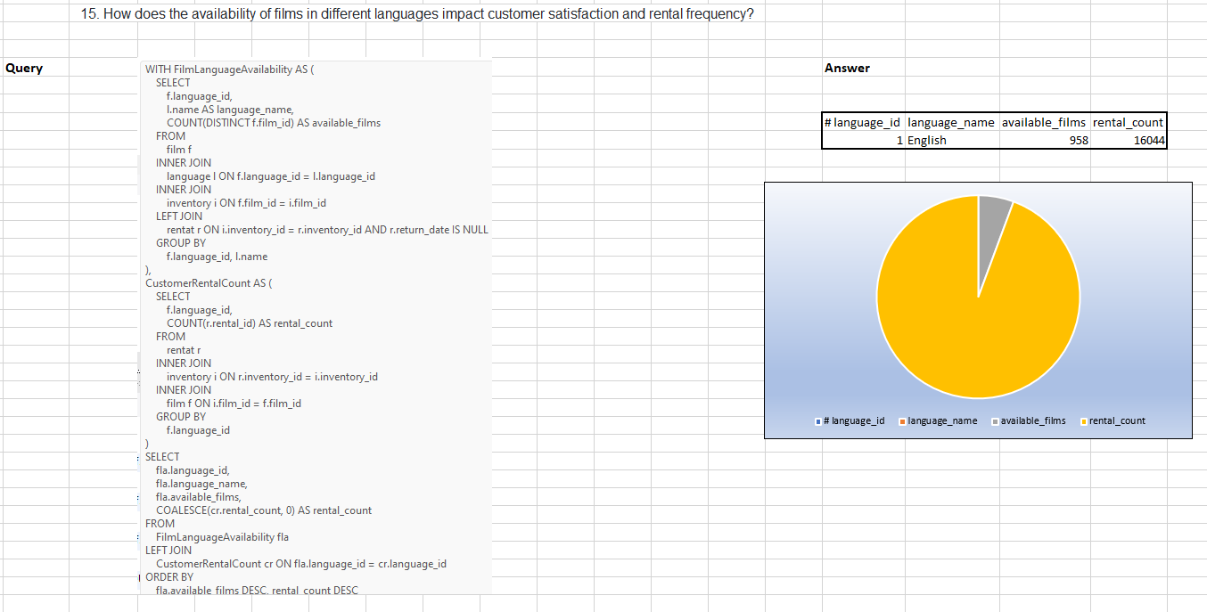
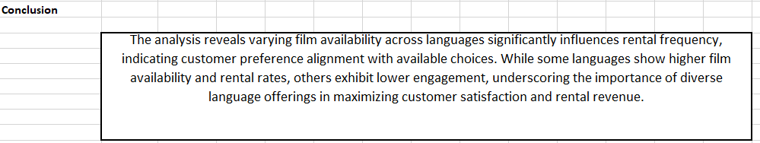

Slide 30
Overall Conclusion on Sakila Movie Rental Analysis
The Sakila Movie Rental Analysis project provides a comprehensive examination of various facets of the Movie Rental business, offering crucial insights for enhancing operational efficiency and customer satisfaction. The analysis reveals significant patterns and trends that can guide strategic decision-making.
Customer Analysis: Repeat customers are more valuable, showing higher rental frequency and generating greater revenue compared to new customers. Segmenting customers by age and location reveals preferences for different film categories and languages, helping tailor marketing strategies.
Inventory Analysis: Inventory management is pivotal, with notable variations in the availability of films by rating and language. Popular film categories dominate the inventory, but ensuring a diverse range of films can attract a broader customer base.
Rental Analysis: Rental patterns indicate that films with shorter rental durations are more frequently rented, suggesting a preference for quick entertainment options. Understanding the rental duration by category can optimize inventory turnover.
Store Analysis: Store performance varies significantly by location. Identifying underperforming stores and analyzing their issues can lead to targeted interventions. Locations with the highest customer ratings set benchmarks for best practices.
Film Analysis: Popular film categories have higher rental rates, but niche categories and films in various languages also have dedicated audiences. Ensuring a well-rounded inventory that caters to diverse tastes is essential for customer satisfaction.
Financial Analysis: Monthly sales revenue fluctuates, with peaks likely corresponding to holiday seasons or promotional periods. Payment method distribution highlights the importance of offering multiple payment options to accommodate customer preferences.
Staff Analysis: Staff performance impacts customer experience, with experienced staff members generally contributing to higher average rental durations and better customer interactions. Investing in staff training and retention can improve overall service quality.
Overall, the Sakila Movie Rental Analysis underscores the importance of data-driven decisions in optimizing operations, enhancing customer satisfaction, and driving revenue growth. By leveraging these insights, the rental business can implement strategic improvements to remain competitive and responsive to market dynamics.

